Slide 1





DETECTING SPAM EMAILS
Student Details
Name: MATHIYAZHAGAN R NM Id:au612821105012
College Name:VARUVAN VADIVELAN INSTITUTE OF TECHNOLOGY

Slide 2



Face Emotion and Age Detection
OUTLINE
Problem statement
Proposed system/solution
Algorithm & Deployment
GitHub Link
Project Demo
Conclusion
Future Scope
References

Slide 3
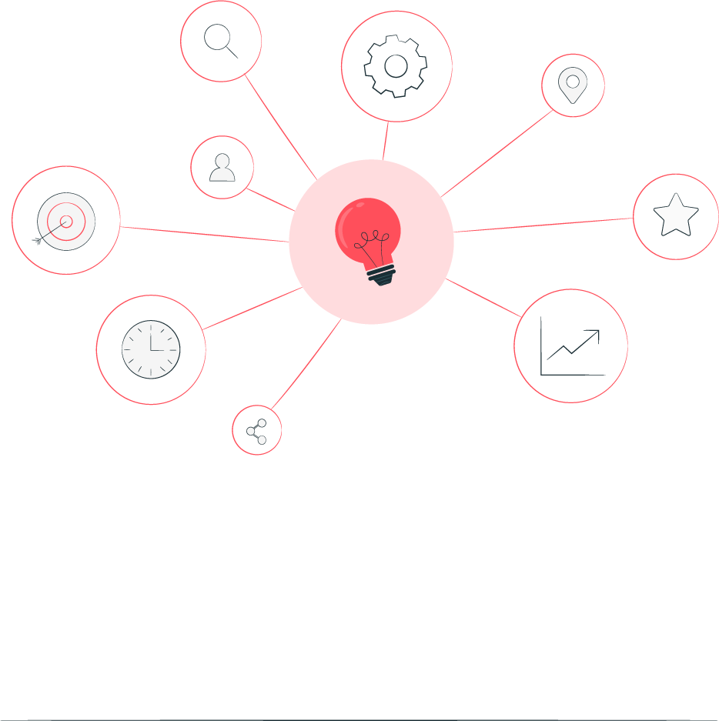
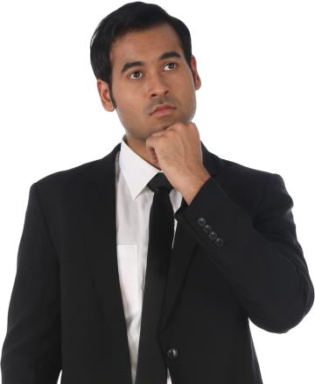
Face Emotion and Age Detection
PROBLEM STATMENT
You are tasked to perform Detecting Spam Emails Using TensorFlow. Implement and build a deep- learning model for Spam Detection.
The model we will try to implement will be a Classifier, which would give binary outputs- either spam or ham. Steps involved

Slide 4


Face Emotion and Age Detection
PROPOSED SYSTEM
.Import dependencies; load and analyze the spam text data. .Split the data into train and testsub-datasets, and text preprocessing.
Train our model using the three deep-learning
algorithms.
Compare results and select the best model. Use the final classifierto detect spam messages.

Slide 5
Face Emotion and Age Detection
ALGORITHM
here are three popular deep learning algorithms commonly used for detecting spam: Neural Networks (CNNs): CNNs are commonly used for image recognition tasks, but they can also be applied to text classification, such as spam detection.
By treating the text as an image, CNNs can learn hierarchical patterns of features in the text, allowing them to identify spammy characteristics. (RNNs): RNNs, especially variants like Long Short-Term Memory (LSTM) networks, are effective for processing sequential data like text.
They can capture dependencies between words in a message, enabling them to detect spam based on patterns or sequences Belief Networks (DBNs): DBNs are a type of neural network that consists of multiple layers of stochastic, latent variables.
They have been successfully applied to various classification tasks, including spam detection. DBNs can learn complex patterns and relationships in the data.

Slide 6
Face Emotion and Age Detection
DEPLOYMENT
.RNNs: Effective at capturing sequential patterns but may struggle with long-range dependencies. CNNs: Excellent at capturing spatial patterns in textual data but may overlook temporal relationships.
LSTMs: Specifically designed to address the vanishing gradient problem in RNNs, making them effective for capturing long-term dependencies in sequential data.
RNNs: Require significant computational resources due to their recurrent nature, making them slower to train compared to CNNs and LSTMs. CNNs: Less computationally intensive than RNNs, especially when dealing with text data, as they can exploit parallelism effectively.
LSTMs: More computationally intensive than traditional RNNs but generally faster to train compared to RNNs due to their ability to capture long-term dependencies more efficiently.

Slide 7
Face Emotion and Age Detection
GITHUB LINK;
https://github.com/mathiyazhagan2004

Slide 8
Face Emotion and Age Detection
Video Of The Project:
https://github.com/mathiyazhagan2004/MATHIYAZHAGAN-ANMLdetecting spam emails

Slide 9

Face Emotion and Age Detection
CONCLUSION
Recurrent Neural Networks (RNNs) excel at capturing sequential patterns but may struggle with long-range dependencies and require significant computational resources.
Convolutional Neural Networks (CNNs) are effective at capturing spatial patterns and are less computationally intensive, making them suitable for text classification tasks like spam detection
Long Short-Term Memory Networks (LSTMs) address the vanishing gradient problem in RNNs and are more scalable, offering improved performance for tasks requiring capturing long- term dependencies.

Slide 10
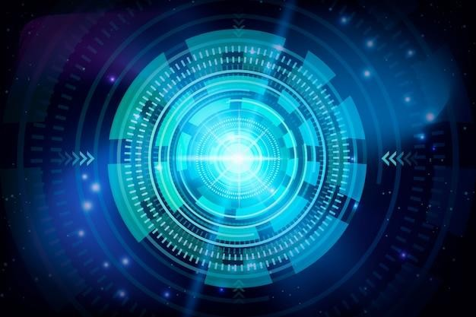
Face Emotion and Age Detection
Future Scope
Recurrent Neural Networks (RNNs) excel at capturing sequential patterns but may struggle with long-range dependencies and require significant computational resources.
Convolutional Neural Networks (CNNs) are effective at capturing spatial patterns and are less computationally intensive, making them suitable for text classification tasks like spam detection.
Long Short-Term Memory Networks (LSTMs) address the vanishing gradient problem in RNNs and are more scalable, offering improved performance for tasks requiring capturing long- term dependencies.

Slide 11
Face Emotion and Age Detection
Reference
Deep Learning for Email Spam Detection: A Survey” by S. K. Pandey, et al. (2018)
“Spam Detection in Social Media Using Deep Learning” by A. Kumar, et al. (2019)
“A Survey on Deep Learning Techniques for Email Spam Detection” by R. Kaur, et al. (2020)
“Spam Email Detection Using Deep Learning Techniques” by A.
A. Tijjani, et al. (2021)

Slide 12
Thank you!
Face Emotion and Age Detection

